Slide 1
Contents
Layers of Docker/Container Image
What is a Dockerfile?

Slide 2
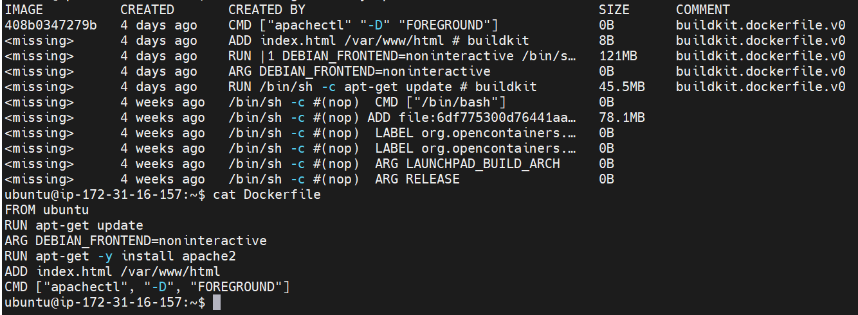
Layers Of Container Image

Slide 3
Dockerfile
Docker can build images automatically by reading the instructions from a Dockerfile
A Dockerfile is a text document that contains all the commands a user could call on the command line to assemble an image

Slide 4
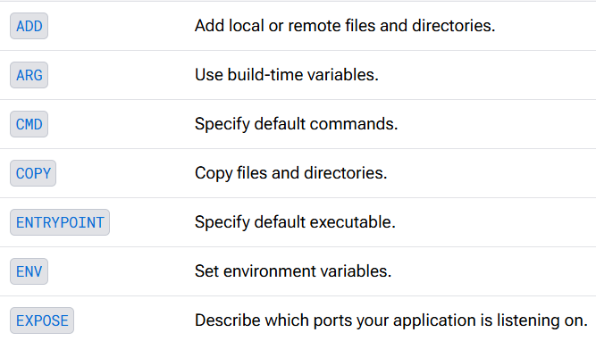
Dockerfile Instructions
Dockerfile Instructions: https://docs.docker.com/reference/dockerfile/

Slide 5
Commands
docker build -t <dockerhub-username>/<Image-Name>:v1 .
docker run -d --name webapp -p 80:80 <dockerhub-username>/<Image-Name>:v1

